Slide 1
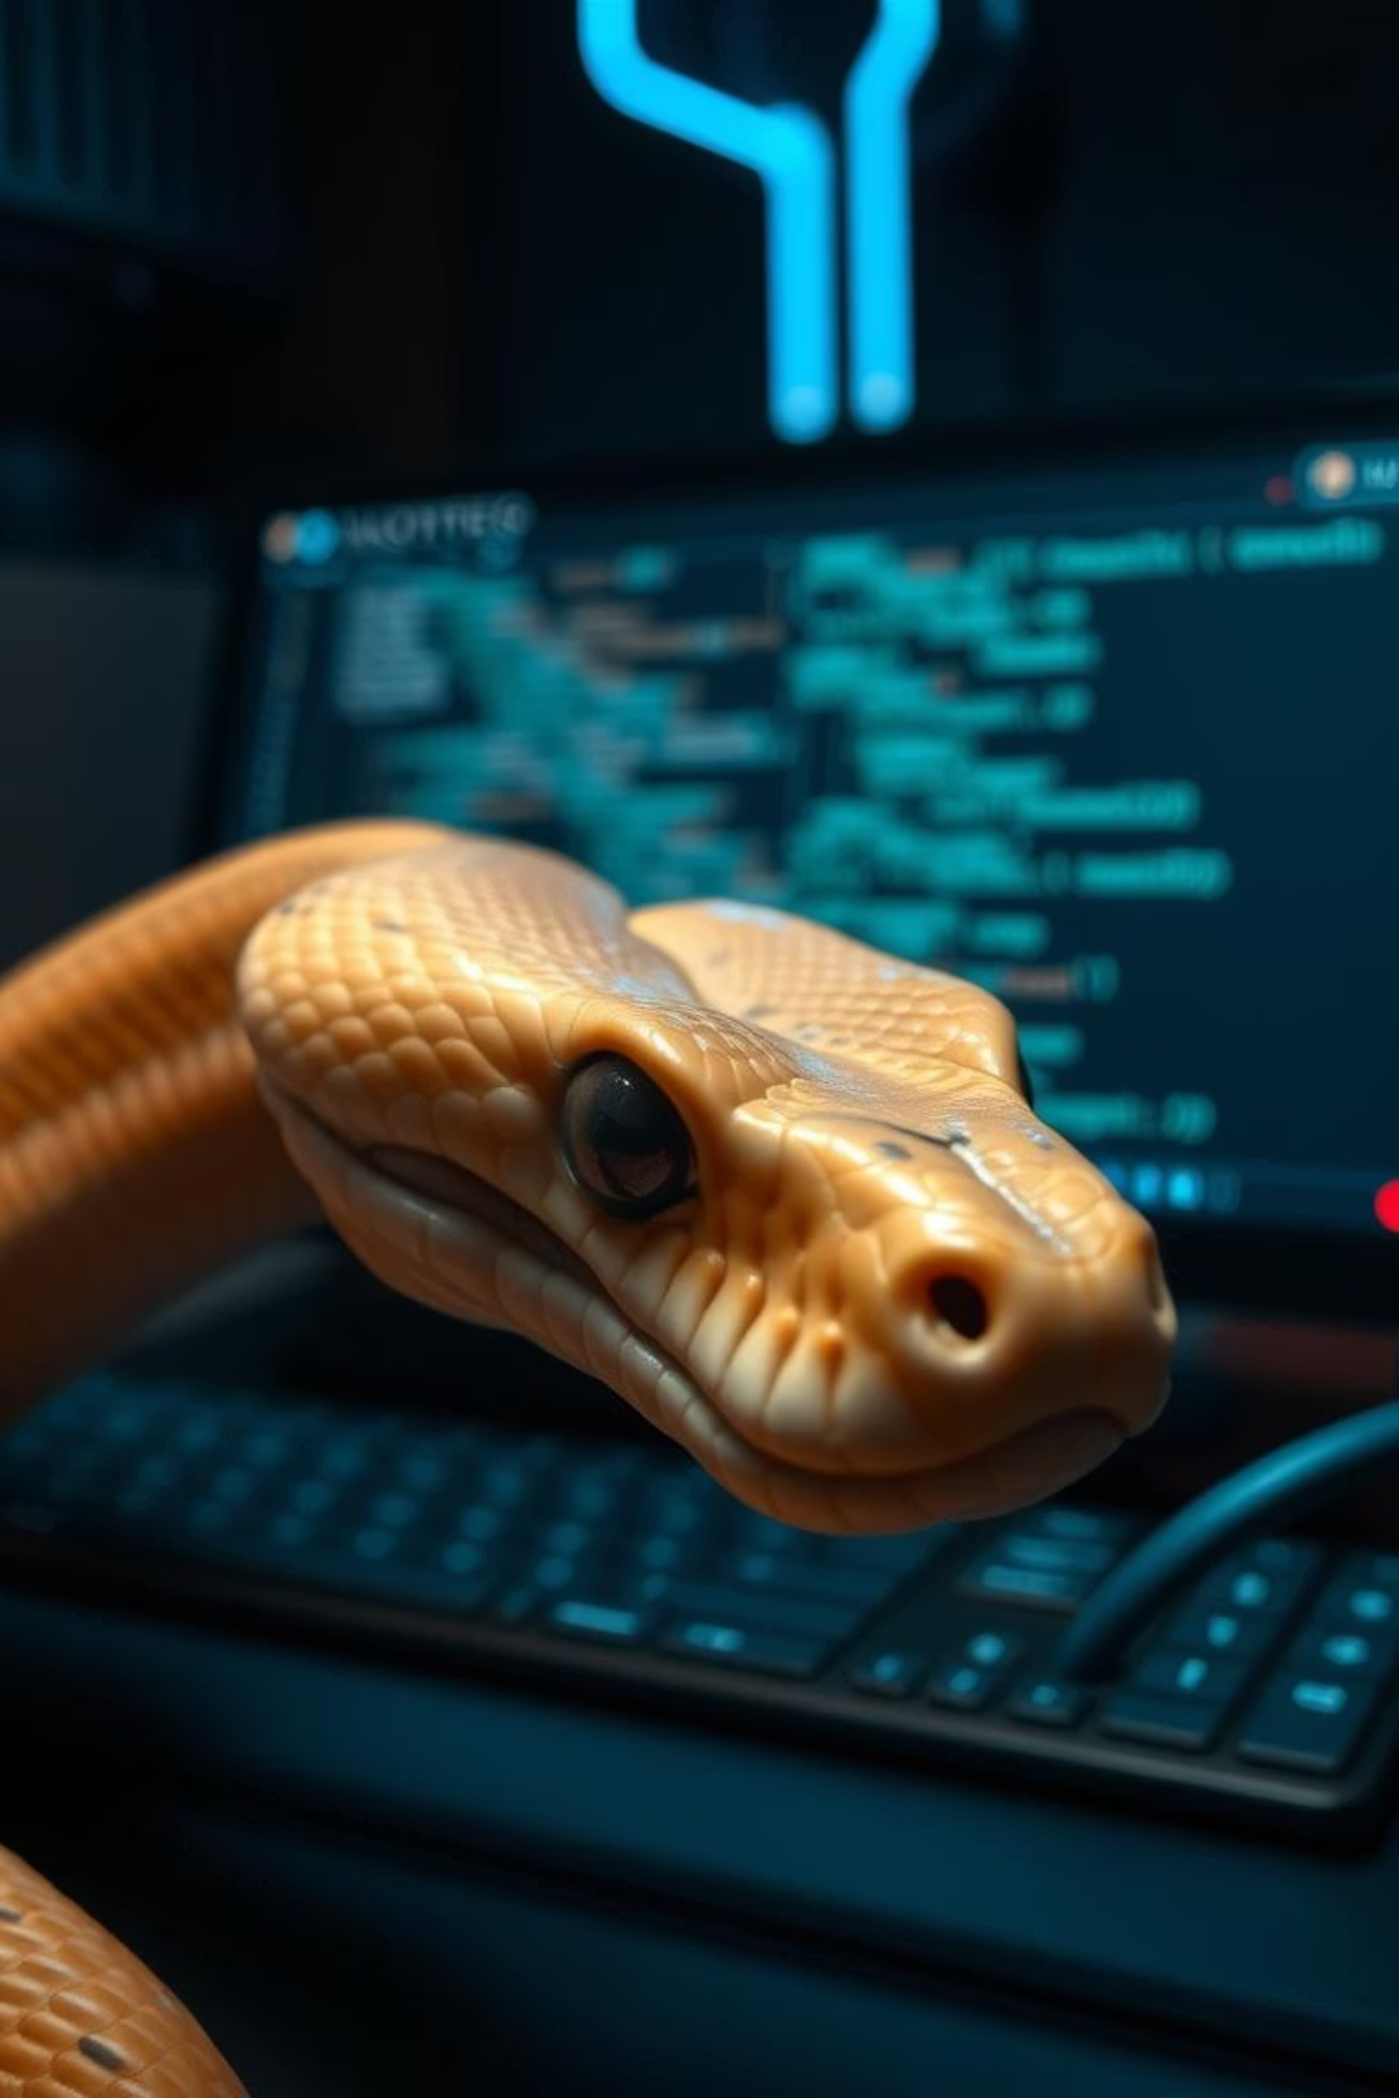
PowerPoint Presentation: Task 3 - Plagiarism Checker using Python
SS
by SYED Shahid

Slide 2
Slide 1: Title Slide
Project Title: Plagiarism Checker using Python
Subtitle: Text Similarity with TF-IDF & Cosine Similarity
Presented by: Syed Shahid
Organization: SLASH MARK IT Solutions
Date: 30/05/2025

Slide 3
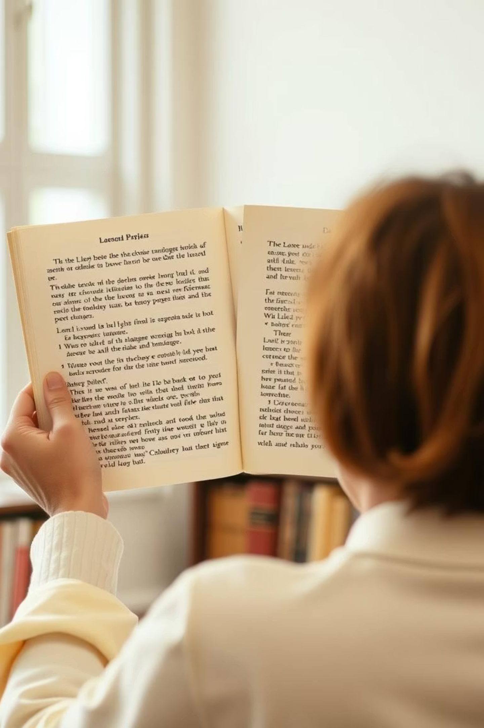
Slide 2: Introduction
Objective
Background
Compare two text files and calculate similarity
Plagiarism detection is essential in academics
Relevance
Manual checking is inefficient and error-prone

Slide 4

Slide 3: Problem Statement
Manual plagiarism detection is time-consuming
Need for automated tool using machine learning techniques
This project solves it using basic NLP and math

Slide 5
Slide 4: Project Scope
Inclusions:
Exclusions:
.txt file comparison
Grammar or paraphrase detection
TF-IDF
Constraints:
cosine similarity
English text only
plain text input

Slide 6

Slide 5: Literature Review
Tools like Turnitin use advanced NLP
Our method: Simpler, using TF-IDF and cosine similarity
Widely used for document similarity tasks

Slide 7



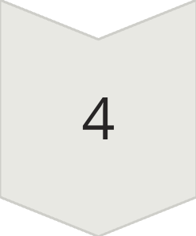

Slide 6: Methodology / Approach
Upload text files in Colab
Read content and preprocess
Vectorize text using TfidfVectorizer
Calculate similarity using cosine_similarity
Show score (0-100%)
📊 Include flowchart here: File1 + File2 → Vectorize → Compare → Score

Slide 8
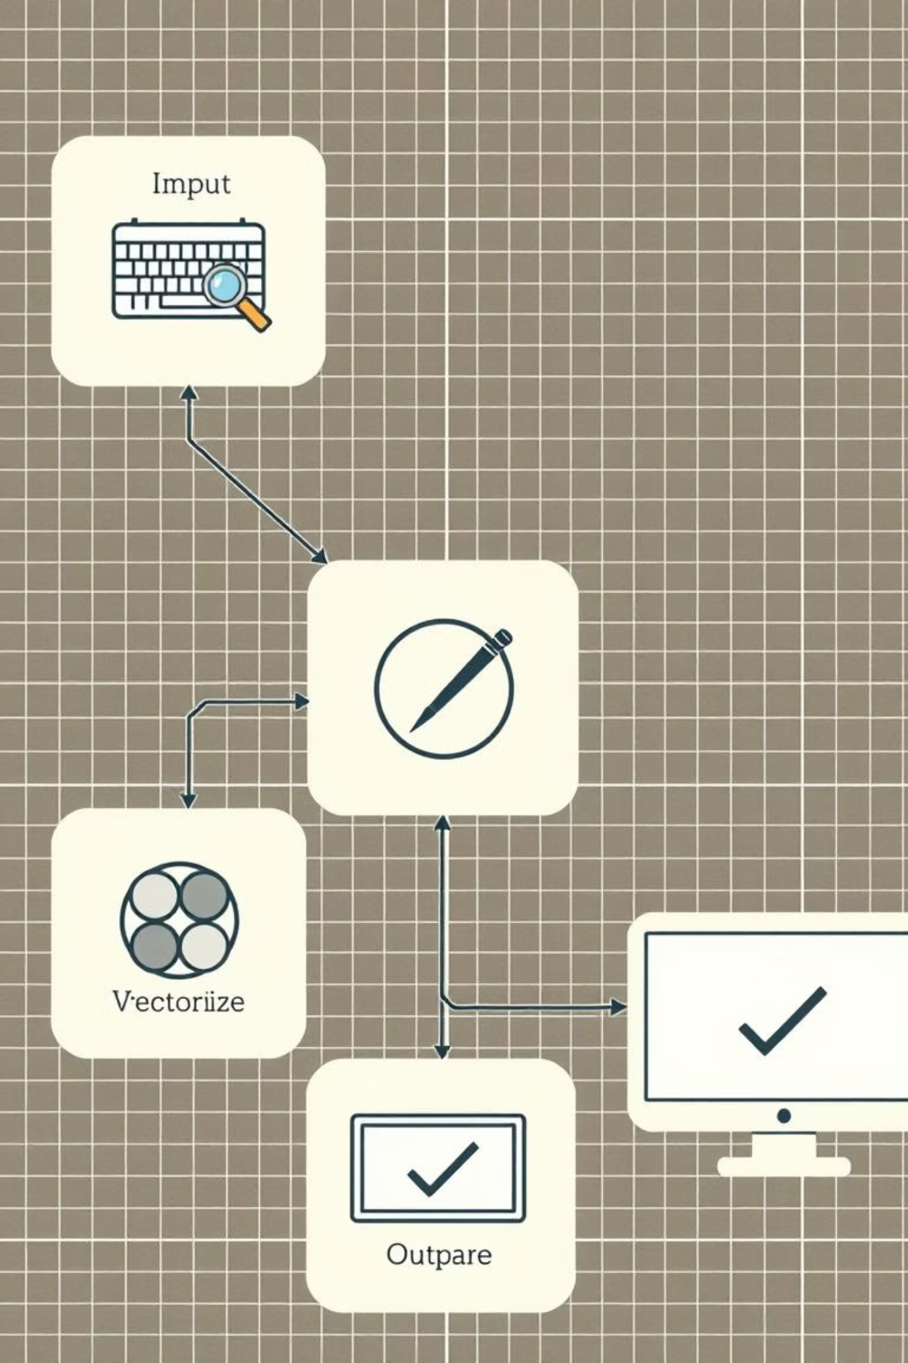
Slide 7: System Design
Diagram: file1.txt → Read → TF-IDF → Cosine → Output
Architecture blocks: Input, Preprocess, Vectorize, Compare, Output
🛠️ Include system block diagram image

Slide 9


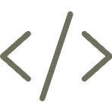


Slide 8: Key Features / Tools Used
Python, Google Colab
scikit-learn (TF-IDF, cosine)
Simple file uploads
Real-time score generation

Slide 10
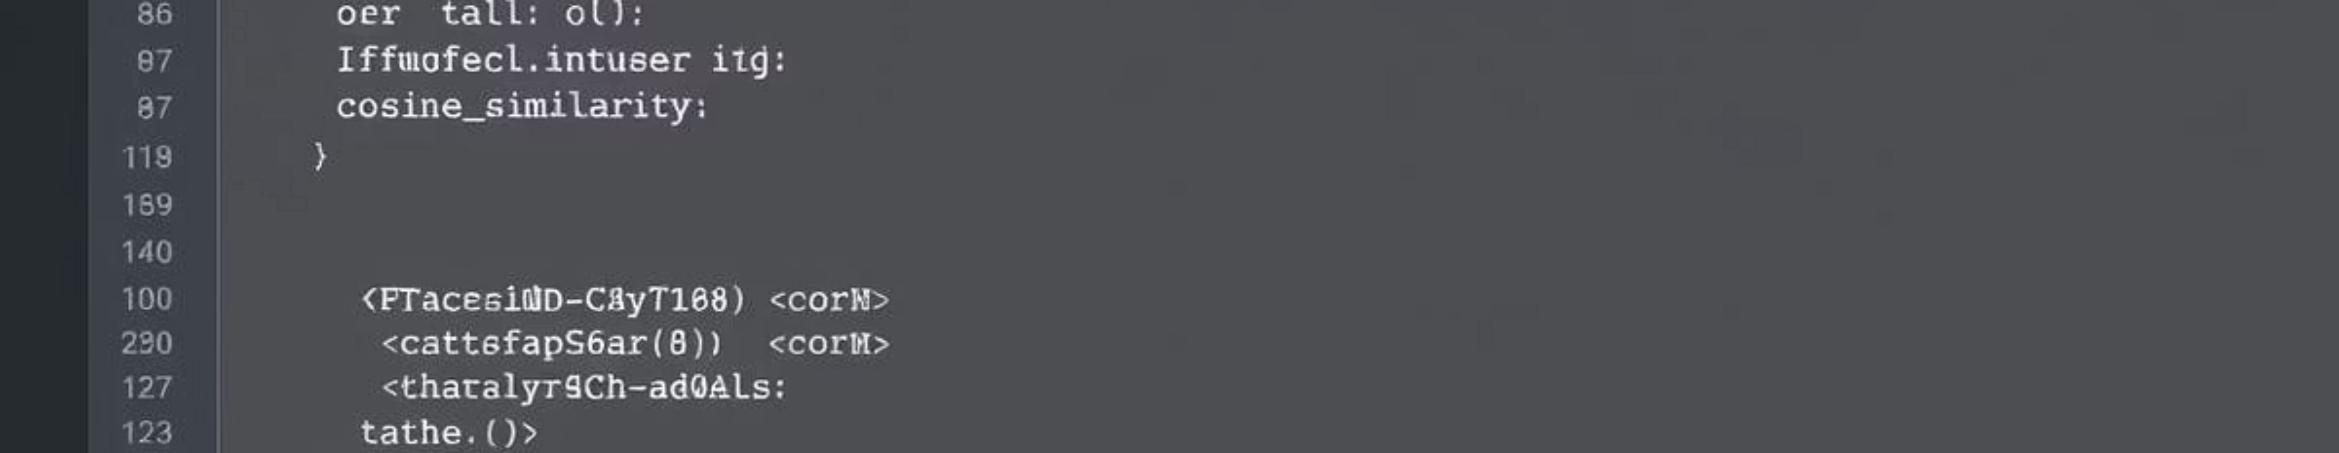
Slide 9: Implementation
Code snippet: TfidfVectorizer + cosine_similarity
Screenshot of Google Colab code
Function: check_plagiarism(text1, text2)

Slide 11
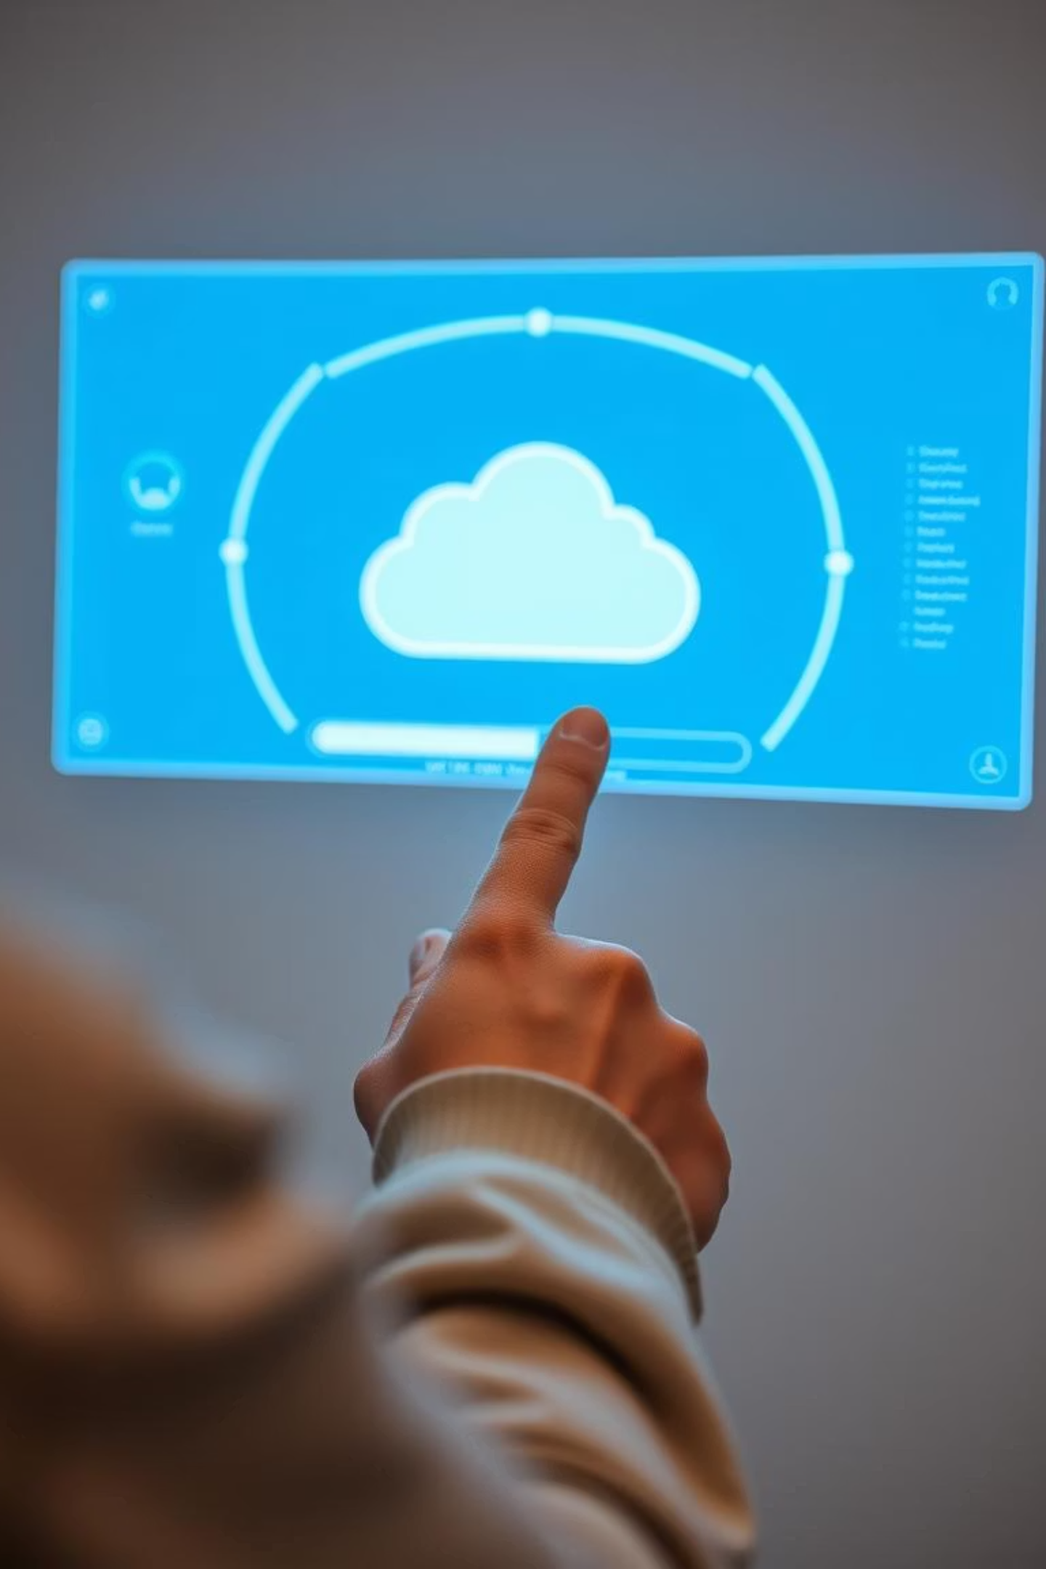
Testing
Uploaded file1.txt and file2.txt
Screenshot: Output showing similarity (e.g., 85.72%)
📈 Table of test results
SS
by SYED Shahid

Slide 12
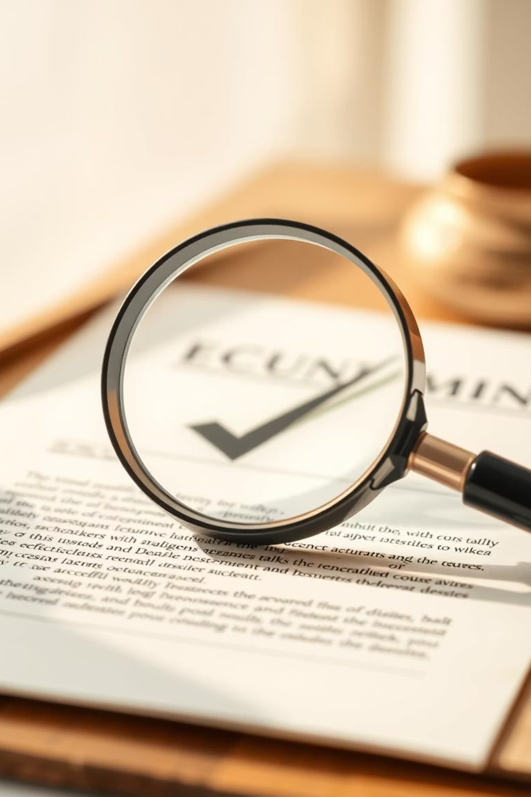
Results
Accuracy
Matches expected results on sample files
Useful for students and educators
Clear output and simple interface

Slide 13





Challenges and Solutions
Handling file uploads in Colab
Errors like FileNotFoundError
Vector representation learning curve
Fixed by proper naming and output validation

Slide 14

Conclusion & Future Scope
Successfully built working plagiarism checker
Future improvements:
Support more formats (PDF, DOCX)
Detect paraphrased content
Compare batches of documents

Slide 15



Acknowledgments
Thanks to Slash Mark IT Solutions
Mentors and teammates

Slide 16
Contact Info
Name:
Email:
GitHub:
Syed Shahid
syedshahid7650@gmail.com
github.com/your-repo

